Slide 1
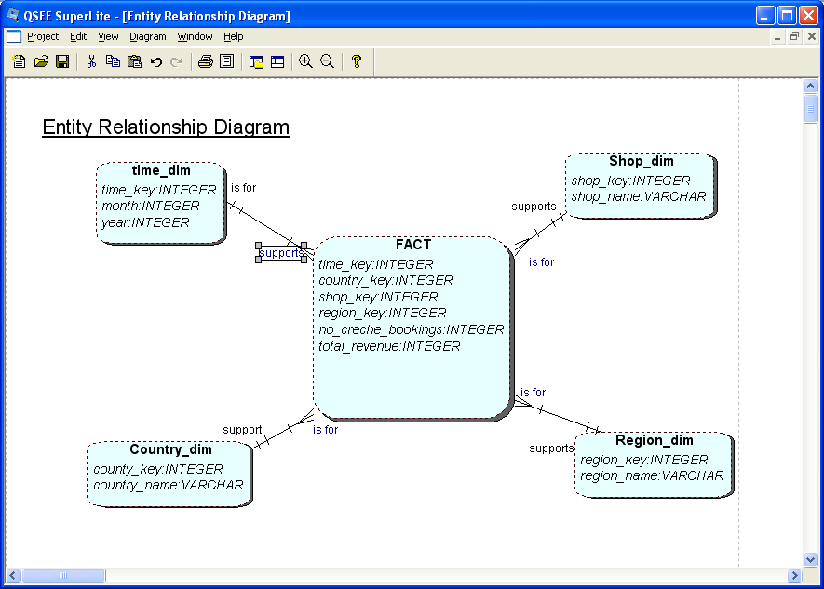
Star schema: Dimensions and FACTs
Notes:
Simple structures for users to understand
Effective data extract achieved through the use of appropriate dimension tables
Aggregated data readily to hand
Drilling possible, as far as data allows
Well tried and understood tools available, both for extracting data and presentation
Drill up/down is slow as requires access to other stars
Drill across and through not so easily understood by users.
Can be problems of scalability
Main point: Needs specific tools (eg better than Access!) if to run efficiently. Eg new forms of indexing of table rows.

Slide 2
Task for the Lecture
Given is this model for Operational sources for Lbu business... Data is coming from 2 different sources...
  Leeds branch
    Customer(custid, name, address, city, phone, DOB, email...
    Product (id, name, description, price
    Agent (agent_no, name, manager, region
    Order (id, order_date, total, notes, quantity, custid, agentid
    ORDER_LINE(orderid, prodid
    Manchester branch
    Customer(custid, first_name, sur_name, address, city, email...
    Product (id, name, description, price
    Order (id, date, notes, quantity, total, custid, agentid
    ORDER_LINE(orderid, prodid
    Agent (agent_no, name, phone, branch_id
    Branch(Branch_id, Location
    These are reports that will be run on the DW...
  Number of orders made in UK first quarter of the year, in comparison with last year?
  Who is our best customer, in first quarter of this year.
  Total number of orders made in first quarter of the year, in comparison with last year for each branch?
  Who is our best Agent, in the first quarter of this year.
Design the star schema for the DW to be implemented....
  Define, fact table, dimension(s), attributes, keys and measures

Slide 3
Example of Star Schema
time
time_key
day
day_of_the_week
month
quarter
year
item
item_key
item_name
brand
type
Sales Fact Table
time_key
item_key
branch_key
branch
location
location_key
branch_key
branch_name
branch_type
location_key
street
city
country
units_sold
dollars_sold
avg_sales
Measures

